Slide 1

The Tree
Click to begin
IF YOU ARE PRONED TO SEIZURES DO NOT PLAY THIS GAME. (Seriously don’t)

Slide 2

YOU DIED
Return to the title screen

Slide 3
The Tree
You wake up on the side of the road next to a tree in the middle of nowhere. You don’t know where you are or what you’re doing here. A road goes off for miles north and south. What do you do?
Go north
Go south

Slide 4
North
You see a 3 story hotel on the side of the road, and the way back is too long to return. What do you do?
Knock on the door
Peek in the window

Slide 5
South
You continue walking until you see a gas station.
What do you do?
Go in
Keep walking
Go back to the Tree

Slide 6
The gas station
You walk into the gas station and there is no one there. You check behind the cash register and it’s open. There are a few hundred dollar bills sticking out. What do you do?
Leave it alone
Take some hundreds
Take ALL the money!

Slide 7
Further south
You continue walking for hours until you pass out.
Continue >>>

Slide 8
The hotel
You knock on the door and it creaks open. You look to see who opened the door and no one is there. ” That’s weird. “ you say to yourself.
Then you hear footsteps from upstairs. What do you do?
Go upstairs
Look around
Leave immediately

Slide 9
The window
You look in the window and see a little girl hanging from the ceiling from a rope around her neck. What do you do?
Go in
Leave immediately

Slide 10

Hallucinations
You wake up and the sky is purple. The sun is red and there’s no ground. You are falling when suddenly…
Continue >>>

Slide 11
The hotel
You go in and the girl is gone.
Continue >>>

Slide 12
Cash register
You start to walk towards the exit door to leave and you hear footsteps behind you. When you turn around and the room is still empty. What do you do?
Look around
Leave immediately

Slide 13
Theft
You reach in to grab the money when you hear someone walk up to you. You turn around and…
Continue >>>

Slide 14
Back to the Tree
You run and run until you pass out. You wake up next to the Tree.
Which way do you go now?
North
South

Slide 15
Upstairs
You head upstairs and see two rooms, one has a blue door and the other has a red door, which do you choose?
Red door
Blue door

Slide 16
Main room
The room has a staircase on either side and in the front there is the check-in desk with room keys hung up. There is a chandelier hanging above you. The room has a red rug on the floor and there is a door behind the desk. What do you do now?
Go through the door
Go upstairs
Grab a key

Slide 17
The basement
You start down the stairs and the door closes, leaving you in the dark.
Suddenly…
Continue >>>

Slide 18
Secret door
You look around the gas station and there is a spot on the wall were the wall is obviously made of wood instead of stone. There is a hole in the spot as well. You push it and it opens up like a door. The hole is for a doorknob. There are stairs leading down. What do you do?
Go down
Look around some more

Slide 19
Backroom
You look around and find a backroom. There’s not much there but a crate and the restroom. Which do you go to?
Crate
Restroom

Slide 20
Secret room
The stairs lead into a freezer room. There is blood on the floor and animal meat hanging from the ceiling. You start to look around and see a figure standing in the shadows. He takes a step forward and…
Continue >>>

Slide 21
The crate
You look into the crate and there is a human skull. You start to back away and you bump into someone. You turn around and…
Continue >>>

Slide 22
Bathroom
You go into the bathroom and there is a noise of someone running behind you. There is a scream. Where do you hide?
In the stall
Under the sink
Above the door like a ninja

Slide 23
The stall
The person walks up to the stall and…
Continue >>>

Slide 24
The sink
He walks to the stall and looks in. he’s carrying a knife. You run out and leave the gas station and then you see it’s daytime now you turn around to see the person with the knife and…
Continue >>>

Slide 25
Ninja
Boy, you are not a ninja.
Continue >>>

Slide 26
Key
You reach for the key and the room starts shaking. You back up and the chandelier falls and…
Continue >>>

Slide 27
Blue door
You walk in and the door shuts. You run over and it’s locked.
What do you do?
Climb out the window
Bust the door down

Slide 28
Red door
You walk in and the door shuts. You run over and it’s locked.
What do you do?
Climb out the window
Bust the door down

Slide 29
Busting the door down
You start running towards the door and suddenly fly through the window. You land on your back and everything goes black.
Continue >>>

Slide 30
Out the window
You jump out the window and land in a bush. The sun is rising. You limp back to the tree and as son a you touch it…
Continue >>>

Slide 31
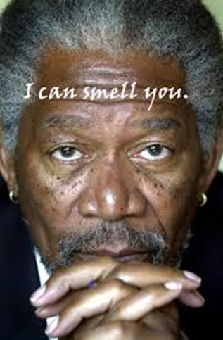
You won!!!

